Slide 1
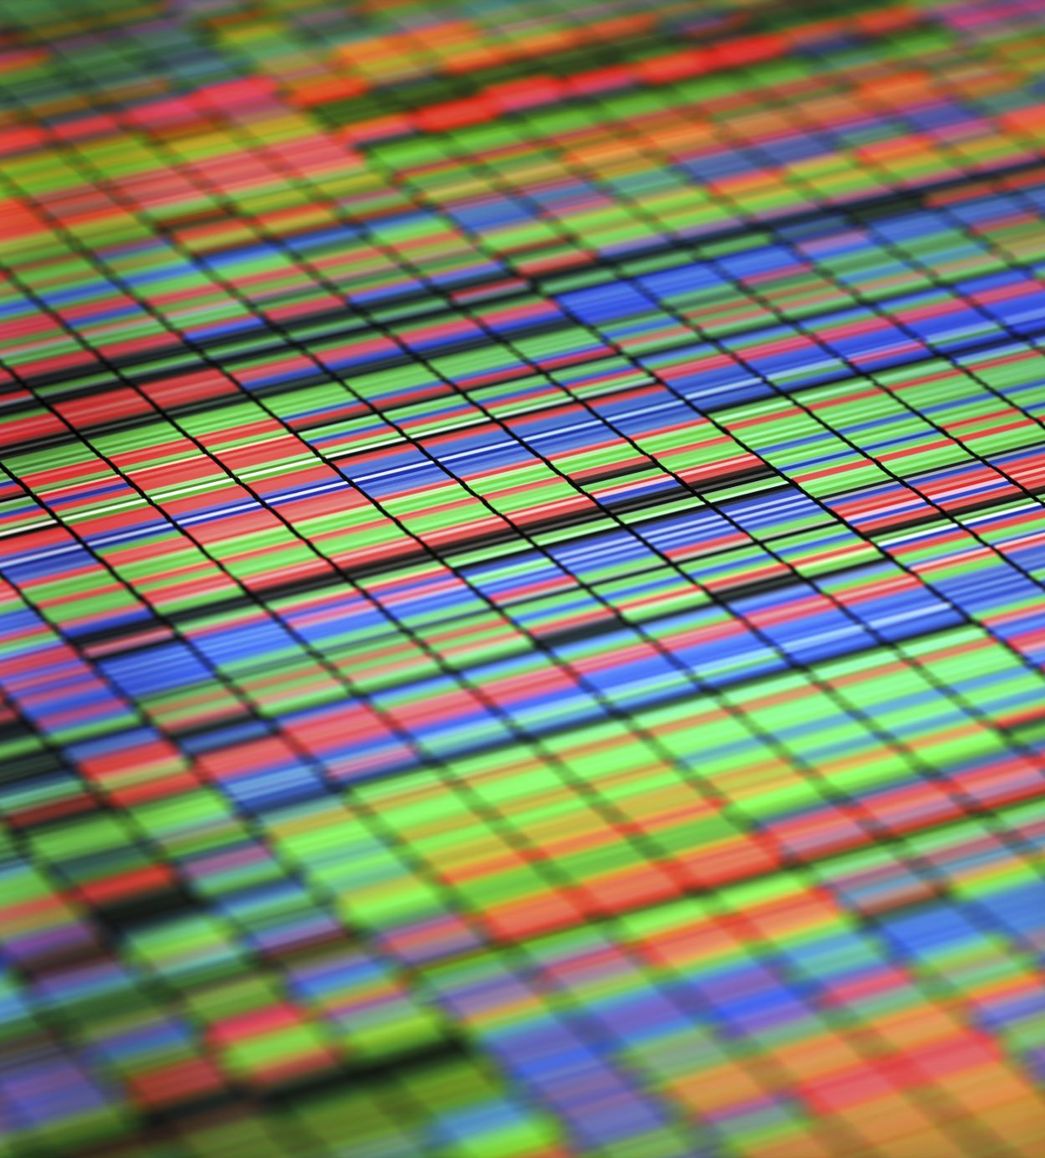
Graph algorithms

Slide 2
algorithms
we need to have a graph to find the shortest for grapping certain medicine. After some search we found some algorithms like :
BFS , A* , Dijkstra and Bellman-Ford but we found that bfs or A* can be used for our project here is a little comparison between them :

Slide 3
Bfs or A*
BFS: A*:
Time complexity: O(|V| + |E|) O(|V| log(|V|) + |E|)
implantation complexity : simple hard
Finding shortest path: good very good

Slide 4

Desktop Application

Slide 5



Pyqt5 or Pyside or C++ windows form

Slide 6
Pyqt5 or Pyside or C++ windows form
We use C++ along our study in the university but we decide to choose python for our desktop application because it will more efficient in the scale of our project plus we will use python in our machine learning model and embedded system.

Slide 7
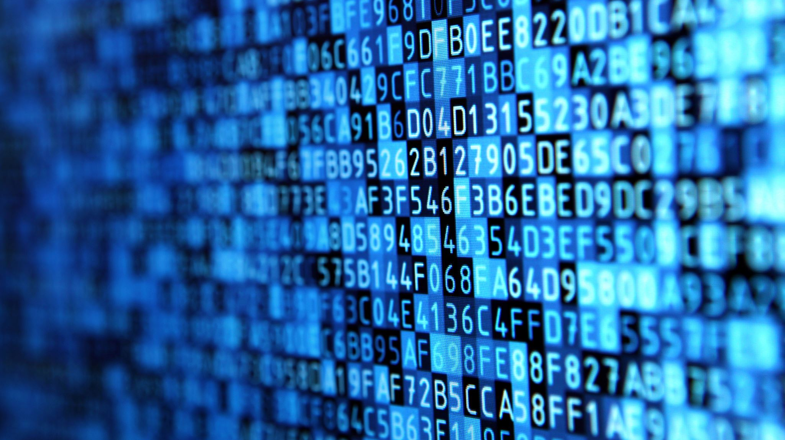
Database

Slide 8

MySQL server
Using a local database server like MySQL for doctors' data and for medicine management because there are in the same for that we don’t need a global database.

Slide 9
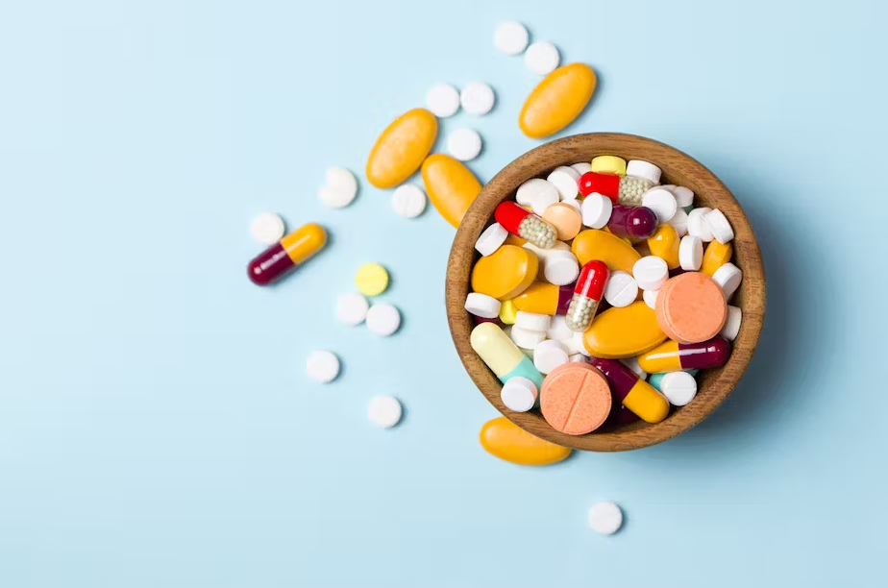
Machine learning model
A machine learning model trained on historical patient data will predict future medication consumption patterns. This predictive capability will inform inventory management strategies and optimize procurement processes, ensuring adequate stock levels. we have two models
Reinforcement
Supervised

Slide 10
Reinforcement vs supervised
Reinforcement : involves an agent learning to make decisions by interacting with an environment. The agent takes actions, receives feedback, and learns to maximize cumulative rewards by exploring different actions and learning from the consequences.
Supervised : he model learns from labeled training data, where each input has an associated output or target. It learns to map inputs to outputs by minimizing the error between its predictions and the actual labels. he model learns from labeled training data, where each input has an associated output or target. It learns to map inputs to outputs by minimizing the error between its predictions and the actual labels.

Slide 11
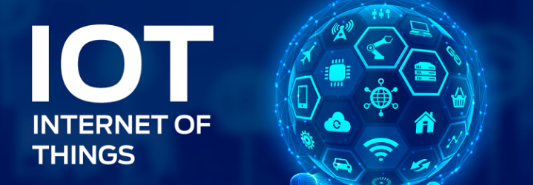
IOT

Slide 12


Smtp vs Mqtt
Receive report from machine learning model to which medicine that have a high consumption the last to order it and don’t waste money for a lot of medicine. So we have two network protocol to send this order:
Smtp
Mqtt

